Slide 1
Anatomy For dummies
Dr Chivaugn Gordon

Slide 2
https://vibrantwellnessjournal.com/2014/02/26/kidney-failure-symptoms-natural-healing/anatomy-kidney-location-female-pelvis-with-kidneys-ureters-bladder-and-pelvic-vessels-shown-identification-of-ureter-during-abdominal-hysterectomy/

Slide 3
The uterus is TINY

Slide 4
View from above
1: Uterus
2: (Round ligament)
3: Broad ligament
4: Fallopian Tube
5: (Ovarian ligament)
6: (Infundibular pelvic ligament)
7: Ovary
8: (Uterosacral ligament)
9: Pouch of Douglas
10: Sigmoid colon
https://www.pngguru.com/free-transparent-background-png-clipart-gwkco

Slide 5
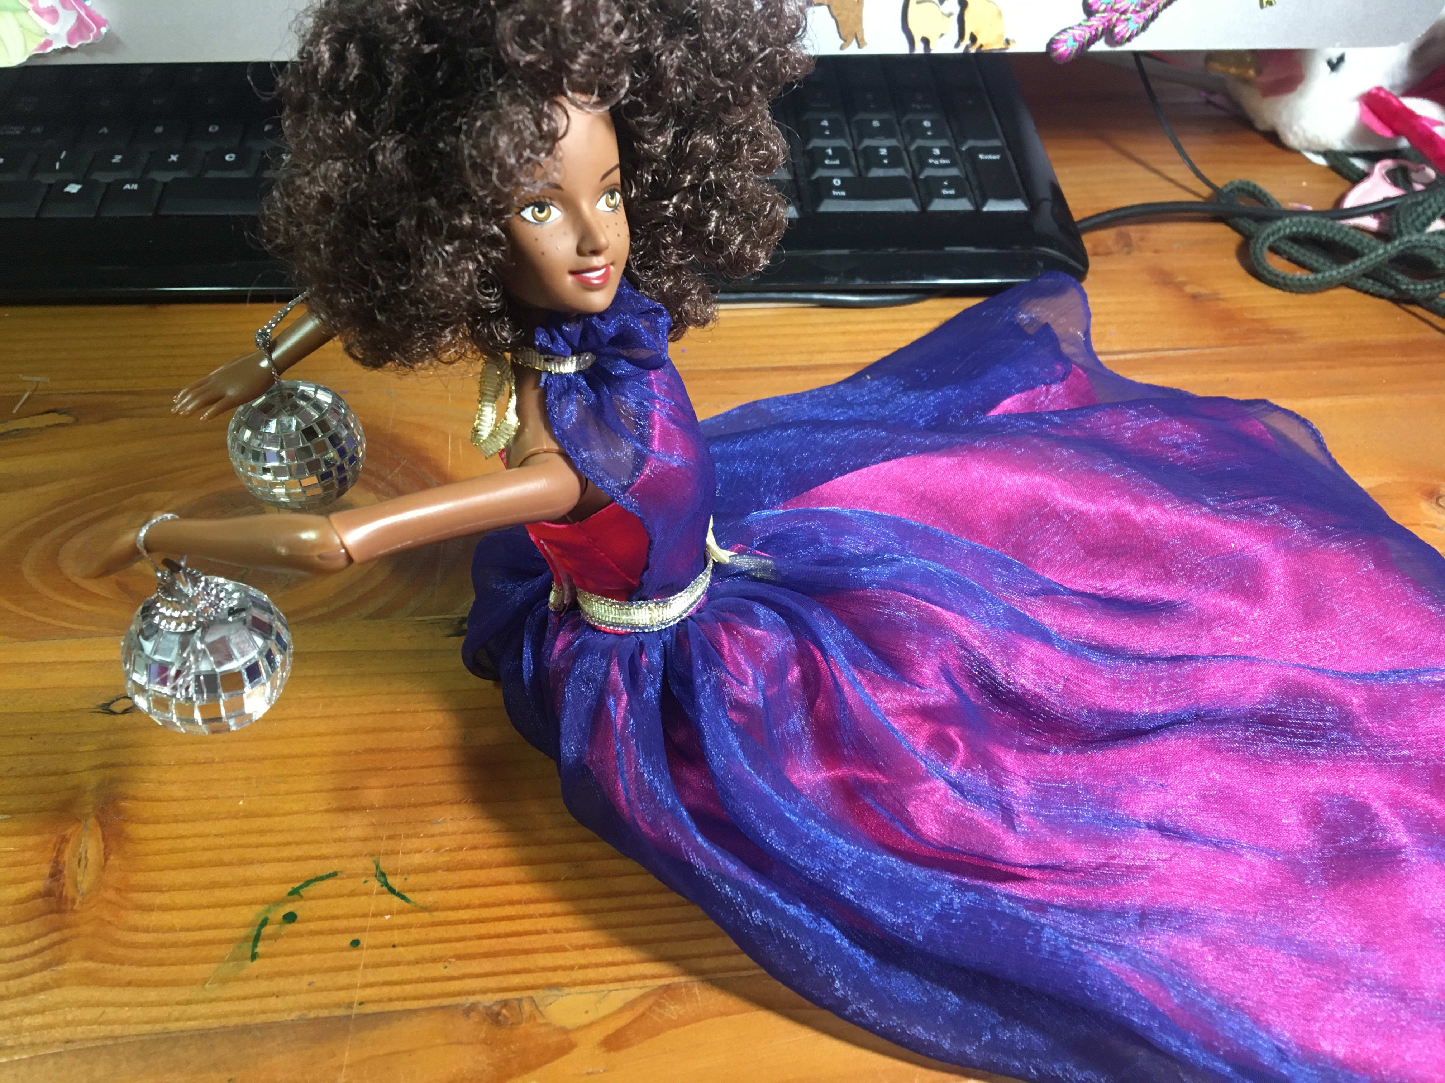
The tubes open into the peritoneal cavity
Relevant because:
Endometriotic deposits can end up on ovary/ in pelvis
Pus from infected tubes can land on ovary>> TOC

Slide 6
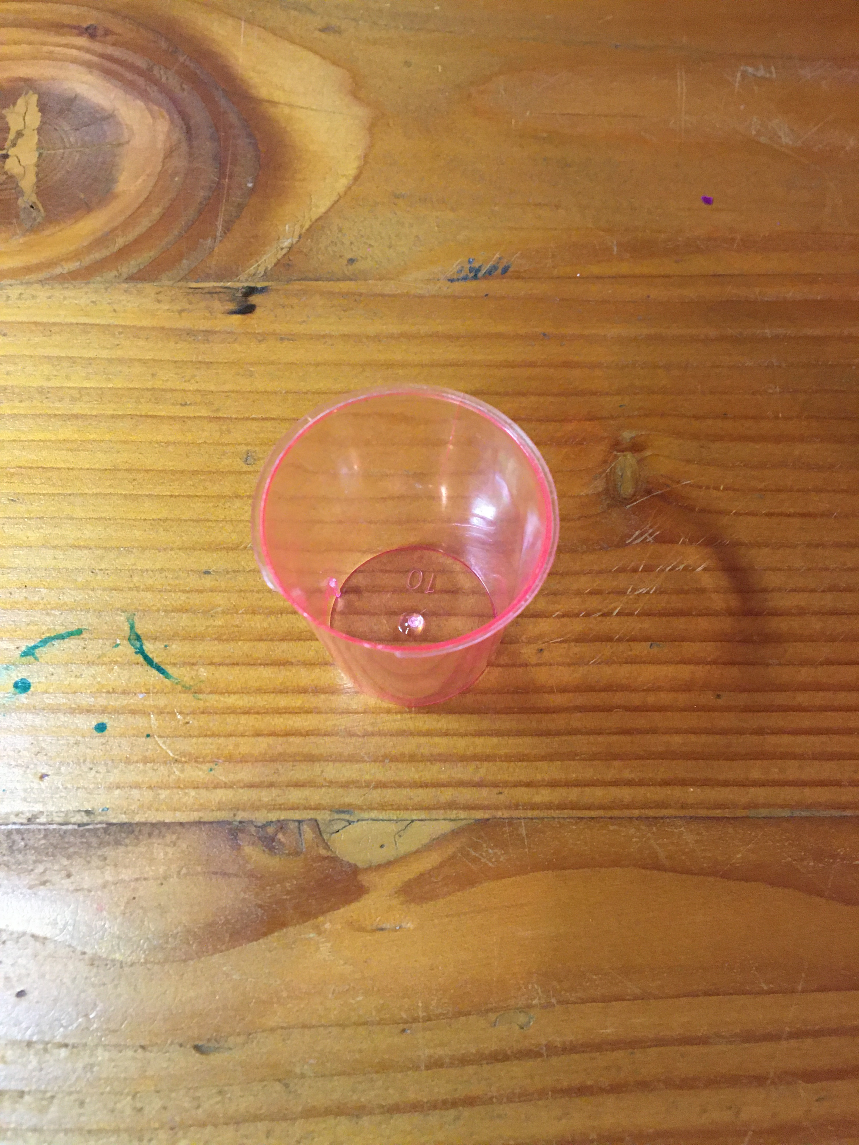
Pouch of Douglas
Fluid here is abnormal
Ruptured ectopic
Pus from PID
Ascites from ovarian cancer

Slide 7
Septums
Relevant because:
Endometriosis can lodge there
Cervical cancer can eat into bladder or bowel>> fistula
Severe obstructed labour or Caesars can cause a vesicovaginal fistula
https://www.anatomynote.com/human-anatomy/pelvis-anatomy/female-pelvis-diagram-lateral-section/

Slide 8
The vagina
Is AT LEAST as long as a Cusco’s speculum.

Slide 9
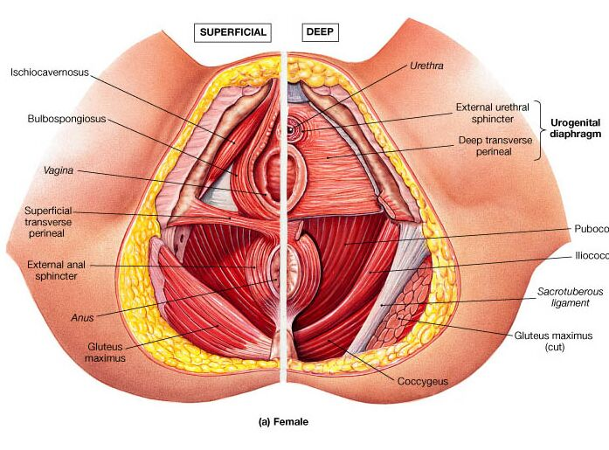
The Pelvic floor
Relevance:
It is part of the sphincter system
Stress incontinence
Multiple deliveries
Instrumental deliveries
https://www.anatomynote.com/human-anatomy/pelvis-anatomy/female-pelvis-anatomy-superficial-view-and-deep-view/

